Slide 1
Waste To WoW: Home Waste Management Recommendation System - Recycling or Upcycling
Team 7
Krishna Sameera Surapaneni
Siddharth Solanki
Sonali Arcot
Vidushi Bhati

Slide 2
Table of contents
01
04
02
03
Project Background
Technology & Soln. Survey
05
Project Requirements
Literature Survey
Project Deliverables

Slide 3
01
Project Background

Slide 4

Project Background and Executive Summary
Project Background
Project Approaches and Methods
Project Contributions and Applications

Slide 5
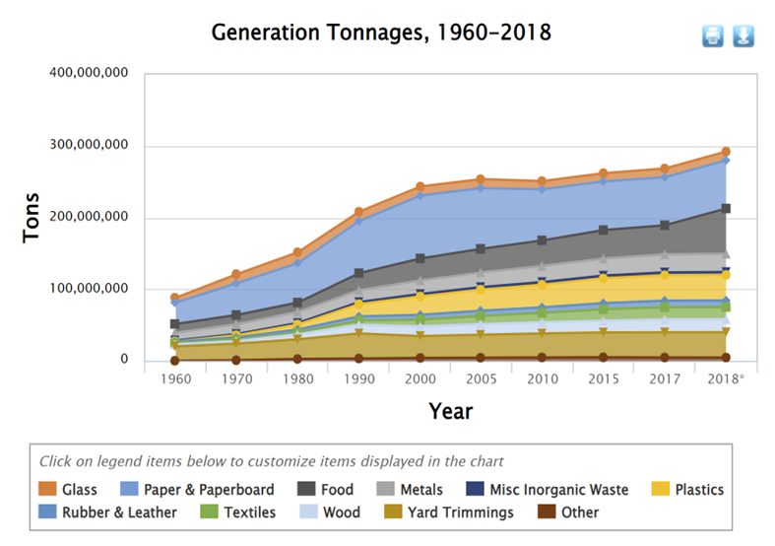
Project Background
Increase of 204.3 million tons in Municipal Solid Waste (MSW) production from 1960 to 2018
Anticipated to rise to 3.4 billion metric tons by 2050

Slide 6
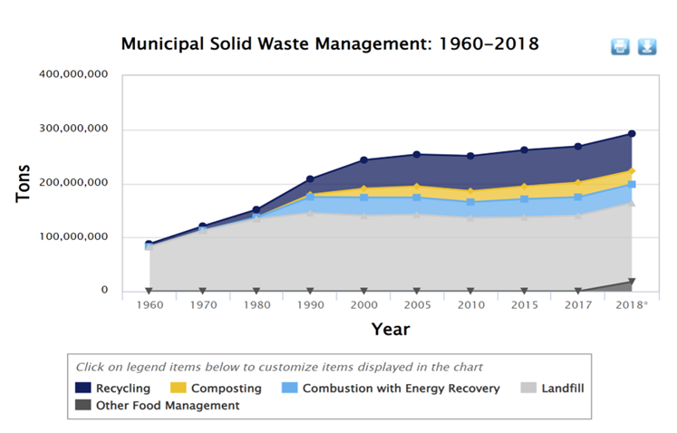
Needs and Importance
146.1 million tons went into landfills in 2018
An American consumer generates nearly 5 pounds daily,
A family produces about 18 pounds, resulting in staggering annual figures of 6,570 pounds per family
Americans discard enough plastic every 15.5 hours to fill AT&T Stadium

Slide 7
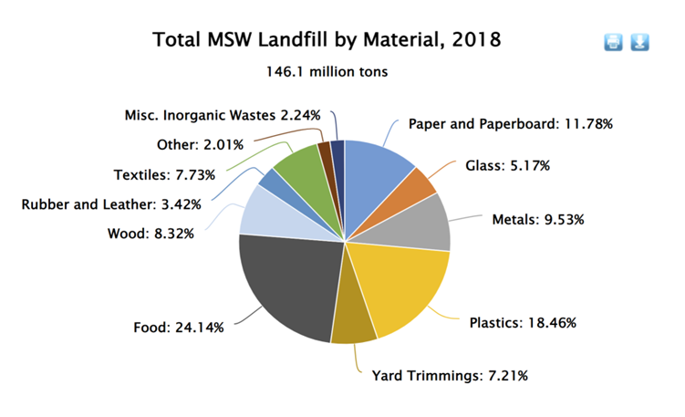
Needs and Importance
Materials with recyclable potential, such as paper and paperboard, frequently go unutilized
304 million Amazon boxes go to landfills yearly
The Harris Poll found that more than 2 in 5 Americans DO NOT correctly sort their recyclables

Slide 8
Needs and Importance
Not Sorting trash properly can lead to contamination and be hazardous
Putting a lithium-ion battery in a dumpster with recyclables could cause a fire that causes a facility to be closed for weeks
Facility may have to deal with expenses for reconstruction, equipment loss, increased insurance rates, and worker displacement—a situation that many businesses cannot endure.
365 fires were reported in 2018 alone, many of which were caused by misplaced things making machinery breakdown

Slide 9
Target Problem
High percentage of inappropriate waste management is due to unawareness of the types of materials that can be recycled and the proper techniques for handling them among individuals. Therefore, it is crucial to educate the users about reducing material consumption or finding ways to reuse, recycle, and upcycle it.

Slide 10
Target Problem
This study aims to address this problem by developing a system for categorizing trash by offering guidelines for reusing, recycling, and recommending safe domestic waste disposal with the help of state-of-the-art technologies such as Object detection, Object classification, large language models, and Google Maps API integrations. The users will be able to identify the type of trash and will be given options to reuse, recycle, donate, or dispose of it according to the selected category.

Slide 11
Motivation
Resources are limited, recycled items can be a great raw material.
Reduce time, money, resources spent by municipalities for waste segregation.
Reduce Pollution, minimize landfills, strengthening economy by effectively creating new recycled products.

Slide 12
Goals
Goals is to empower households with an effective waste management tool
To guide users for proper waste disposal
Encourage reduction in consumption, recycling and upcycling
Minimize environmental harm
Create a more environmentally conscious society
Ensuring economic growth.

Slide 13
Project Background and Executive Summary
Project Background
Project Approaches and Methods
Project Contributions and Applications

Slide 14
Project Approaches and Methods
Defining the problem statement and goals
Business Understanding
Deploying the production-ready model with UI
Deployment
Data Understanding
CRISP-DM
Collecting and exploring data
Evaluating models using
KPIs
Evaluation
Data Preparation
Modeling
Training and testing selected models
Preprocessing and preparing
data for Modeling

Slide 15
Project Background and Executive Summary
Project Background
Project Approaches and Methods
Project Contributions and Applications

Slide 16
Project Contributions and Applications
Accurate categorization using state-of-the-art Object detection and classification models
Mitigating household dilemma of determining proper handling of trash
Integrating with Large language model and Google Maps for coherent and tailored recommendations
Recommendations are both actionable and easy to understand
Sustainable waste management approachable for users of all ages and backgrounds

Slide 17
Project Contributions and Applications
Helpful for municipalities for spending less time on sorting, using less resources, time, and money
Helpful for manufacturing factories to gain access to better recycled raw materials
Reduction in landfills and harmful gas emissions
Useful for underprivileged for getting more options at donation centers
Useful for wildlife as contaminated trash does not leak into soil and oceans
Households can earn money by returning empty California Redemption Value (CRV) containers as per law (5 or 10 cents per container)
Fostering an eco-friendly society

Slide 18
02
Project Requirements

Slide 19
Project Requirements
Functional Requirements
AI Requirements
Data Requirements

Slide 20
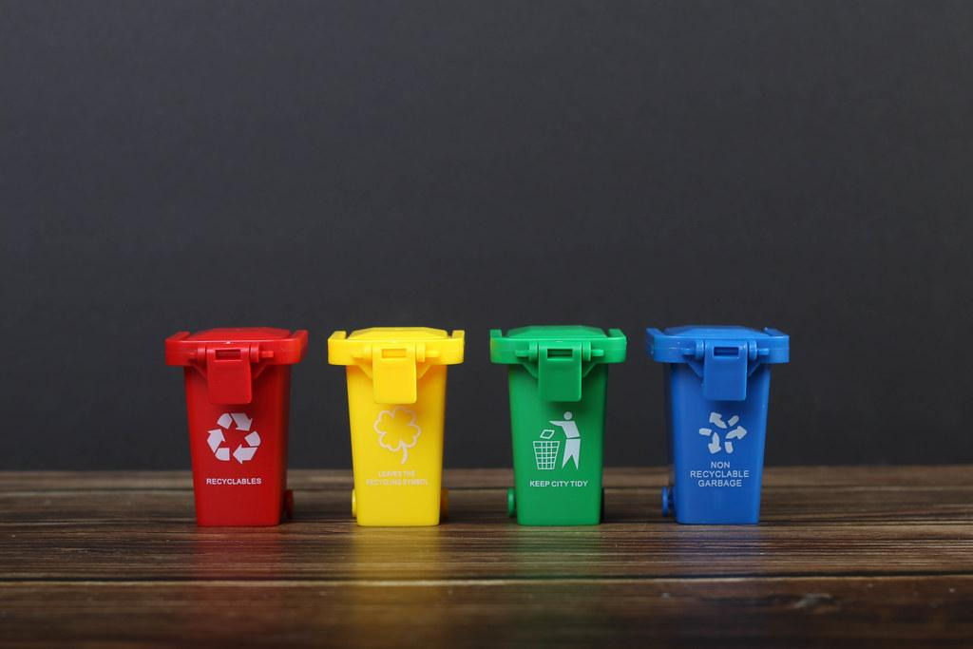
FUNCTIONAL
REQUIREMENTS

Slide 21
Functional Requirements
System handles diverse array of waste and categorizes into subcategories like cardboard, battery, etc.
Determine broader category: Organic, Recyclable, Hazardous, or Homegoods
User-friendly & Aesthetically appealing design
Easy to spot real-time trash detection on main screen
Tool identifies the item's category
LLM and Google Maps API integration for recommending disposal or reuse based on classification

Slide 22



Categories
Recyclable
Biodegradable
Homegoods
Hazardous
-Cardboard
-Paper
-Plastic
-Fruits
-Vegetables
-Bread
-Furniture
-Lamp
-Clothes
-Battery
-Face Mask
-Syringe

Slide 23
Recommendation
Recycle trashcans or suggest suitable places to recycle
DIY projects
Reuse
Recycle
Dispose
Donate
Suitable places to dispose hazardous waste
Suitable places to donate household items

Slide 24
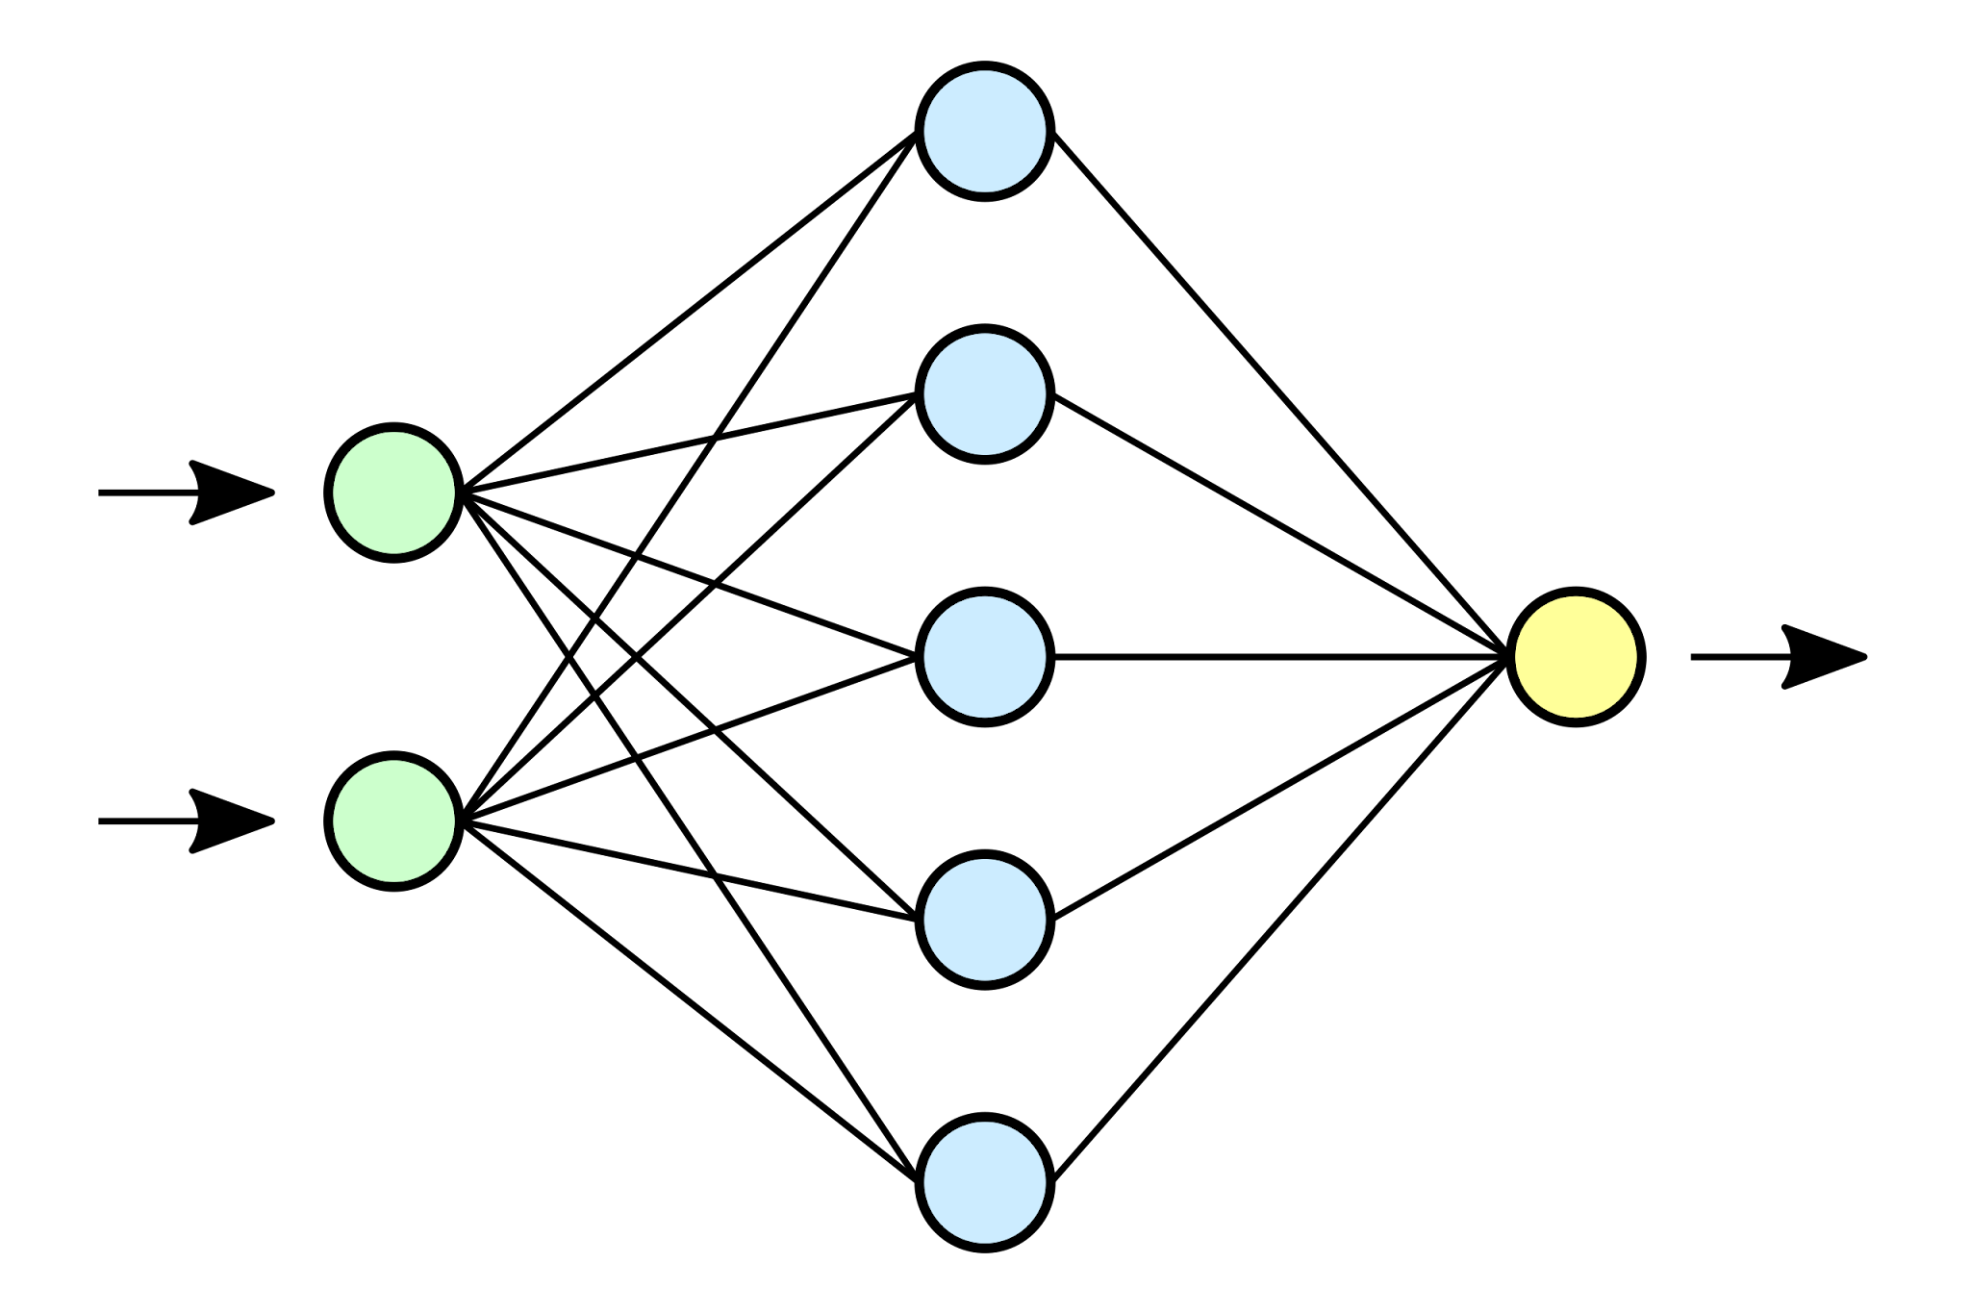
AI REQUIREMENTS

Slide 25
AI Requirements
Requirements
Tools
Models
Hybrid Models
Object Detection and Classification Models
Large Language Models
Location search API
YOLOv8, MobileNetV2, Xception, and ResNet-50
InceptionResNetv2, with SVM to enhance accuracy
Llama 2
Google Maps API

Slide 26
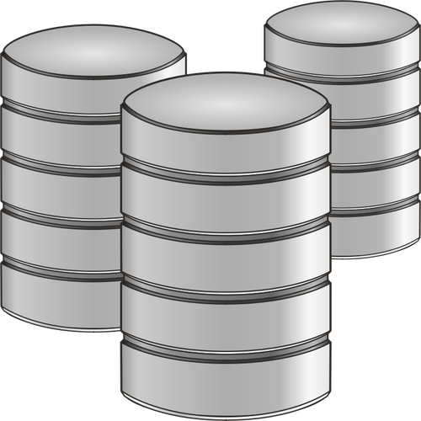
DATA REQUIREMENTS

Slide 27
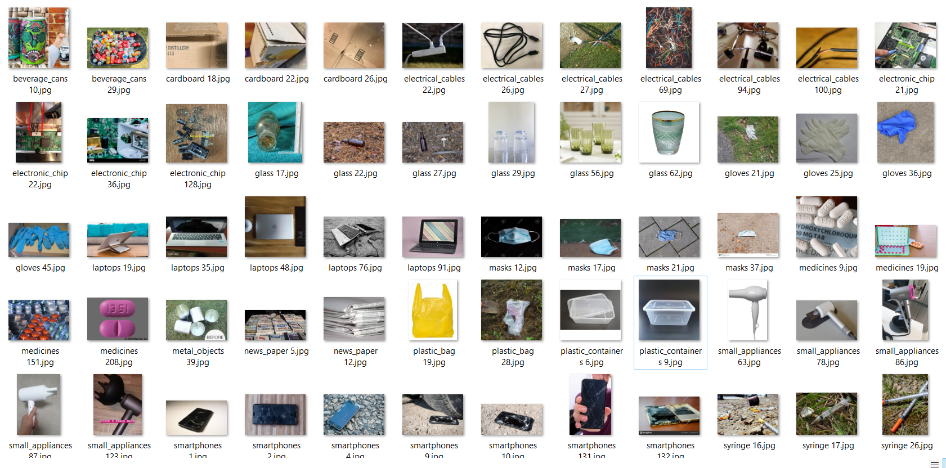
TrashBox Dataset - 17785 images

Slide 28
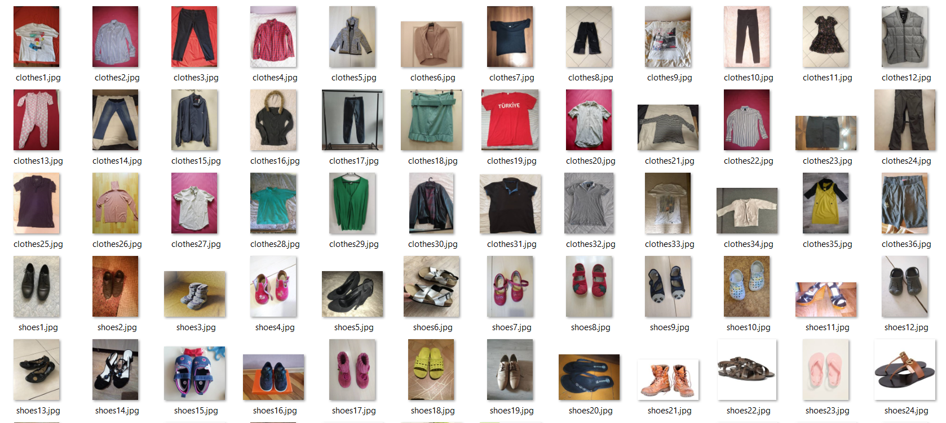
Garbage Classification Dataset - 15150 images

Slide 29
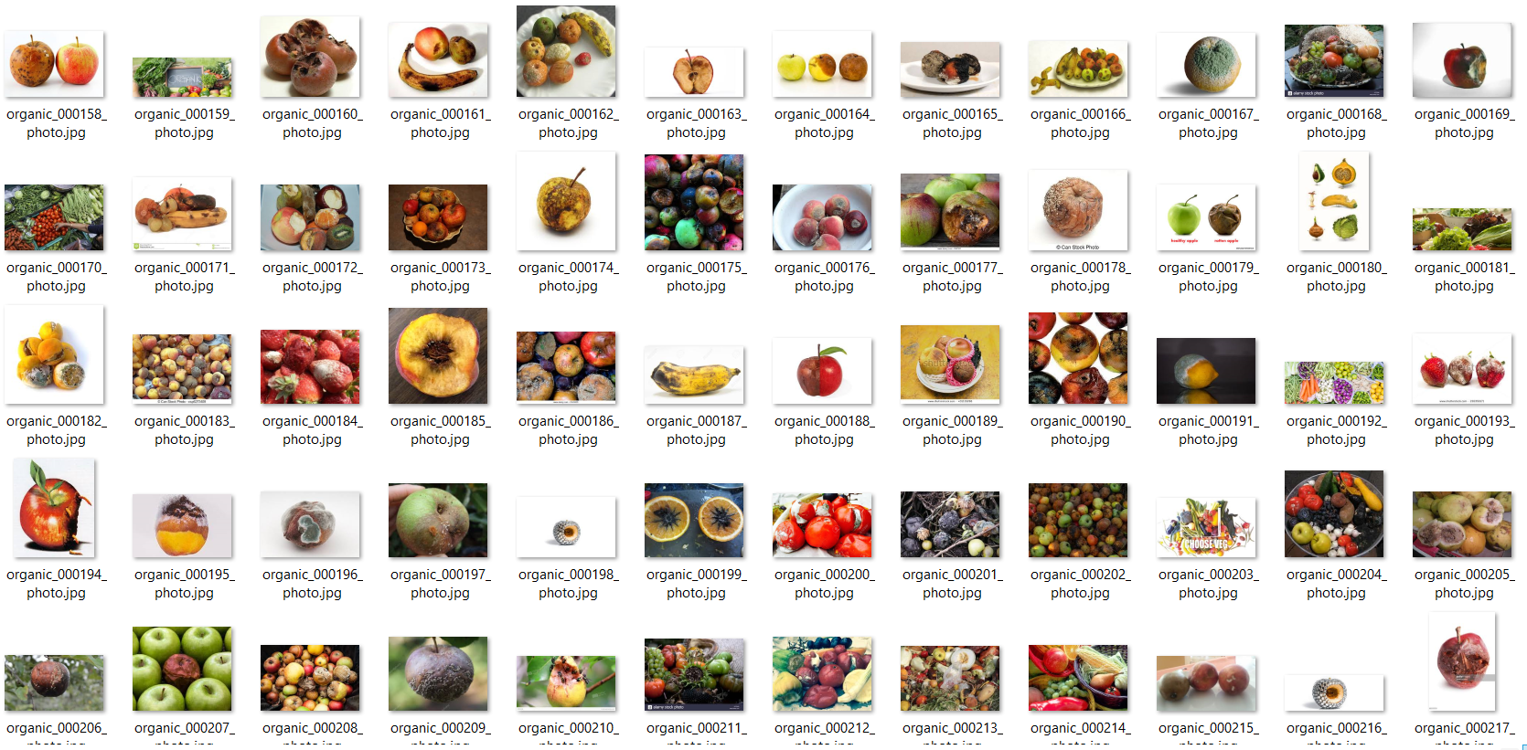
Dataset(Organic & Recyclable) - 24705 images

Slide 30
03
Project Deliverables

Slide 31
Deliverables
Item No | Deliverable | Description | Due Date
1. | Project Proposal | Document outlining the objectives, scope, methodology, and expected outcomes for the project. | 09/06/2023
2. | Work Breakdown Structure (WBS) | A hierarchical decomposition of the project's tasks into smaller, more manageable components following CRISP-DM methodology. | 10/10/2023
3. | Gantt Chart | A visual representation of the project schedule, showing the start and end dates of every task and their dependencies | 10/10/2023
4. | PERT Chart | A network diagram that displays the sequence of tasks and their dependencies, as well as the estimated durations and critical path. | 10/10/2023
5. | Project Management Plan | A document that describes how the project will be managed, including a project schedule, milestones, and resource allocation plan. | 10/10/2023

Slide 32
Deliverables
Item No | Deliverable | Description | Due Date
6. | Data Collection Plan | A document that outlines the specific data that will be gathered and how it will be collected. | 10/10/2023
7. | Data Exploration | Performing Exploratory Data Analysis on the retrieved data using data visualization and statistical analysis. | 10/24/2023
8. | Data Cleaning and Preprocessing Code | Code to perform data cleaning and preprocessing tasks, such as removing duplicates, filling in missing values, and transforming data types. | 10/24/2023
9. | Modeling | Code to build models using YOLOv8, MobileNetV2, Xception, ResNet-50 for trash detection and classification. | 10/24/2023
10. | Performance Metrics | Defining the key performance indicators that will be used to evaluate the efficiency of the models. | 10/24/2023

Slide 33
Deliverables
Item No | Deliverable | Description | Due Date
11. | Model Evaluation and Selection Report | A document that describes the process of selecting the best-performing detection and classification models and the evaluation criteria used. | 11/07/2023
12. | Production-Ready Models | Final versions of the detection and classification models that are optimized for production use. | 11/07/2023
13. | Final Project Report | A document that summarizes the project's objectives, methodology, findings, and conclusions. | 11/28/2023
14. | Project Presentation | A presentation that summarizes the key aspects of the project, including the problem statement, methodology, findings, and conclusions. | 12/05/2023

Slide 34
04
Technical & Soln. Survey

Slide 35
Title | Author | Models Used | Result
Intelligent Waste Classification System using Deep Learning convolutional neural network | Olugboja and Wang (2019) | Convolutional Neural Network(ResNet-50) and Support Vector Machine (SVM) | The training accuracy was 94.5%, and testing accuracy was 87%, ensuring a better separation process.
A Domestic Trash Detection Model Based on Improved YOLOX | Liu et al. (2022) | A new trash detection model, i-YOLOX | The i-YOLOX model improved mAP by 1.47%, increased FPS by 40.4%, and reduced parameters by 23.3% compared to the baseline.
Garbage detection and classification using a new deep learning-based machine vision system as a tool for sustainable waste recycling | Jin et al. (2023) | MobileNetV2 with convolutional attention module and transfer learning | MobileNetV2: original 71.4% (770ms), improved 90.7% (600ms); on Raspberry PI: 89.26%, enhanced with GAN: 91.98%.

Slide 36
Title | Author | Models Used | Result
Hybrid approach of garbage classification using computer vision and deep learning | Tatke et al. (2021) | Simple CNN, VGG16, ResNet50, HOG+SVM. | Simple CNN (Adadelta): 93.56%, VGG16: 75.6%, ResNet50 (Adadelta): 95.93%, HOG+SVM: 47.25%
MWaste: A Deep Learning Approach to Manage Household Waste | Kunwar (2023) | Inception V3, MobileNet V2, Resnet 50, and others | InceptionResNetV2 and Xception scored 92% accuracy; MWaste, a real-time waste classification app, uses these for six categories and includes gamified leaderboards for motivation.
"TALLRec: An Effective and Efficient Tuning Framework to Align Large Language Model with Recommendation" | Bao et al. (2023) | Alpaca-LoRA, Text-Davinvi-002, Text-Daviniv-003 etc. | TALLRec excels in few-shot settings, outdoing both traditional and LLM-based methods, rapidly recommends with under 50 samples, and shows cross-domain strength, such as training on movies and testing on books.

Slide 37
Title | Author | Models Used | Result
An On-Device Deep Learning Framework to Encourage the Recycling of Waste | Ekundayo et al. (2021) | MobileNetV2, VGG19, DenseNet201, ResNet152V2, or InceptionResNetV2 | InceptionResNetV2 had 90% accuracy and 1000ms latency; MobileNetV2 and DenseNet201 balanced accuracy, latency, and size optimally.
Solid Waste Classification Using Deep Learning Techniques | Alawi et al. (2021) | AlexNet, DenseNet,SqueezeNet | DenseNet-121 outperformed other CNNs like SqueezeNet-V1.0 in the study, achieving over 94% accuracy, with its dense connections combatting overfitting.
A YOLOV3 System for Garbage Detection Based on MobileNetV3_Lite as Backbone | Han (2021) | MobileNetV3_Lite | After fine-tuning, the model achieved an 89.89% mAP, and a resource-efficient variant used 8.95% memory of YOLOV3-MobileNetV3; on NVIDIA Jetson Nano, it showed 94.56% category and 90.91% quantity accuracy in real-time garbage detection.

Slide 38
05
Literature Survey

Slide 39
Title | Author | Models Used | Result
A Systematic Review of Machine Learning Approaches for Trash Classification | Vidhya (2023) | DenseNet, VGG-19, NASNetLarge, CNN, ResNet, MobileNet, and more. | Deep learning models, particularly CNNs, dominate trash classification with > 90% accuracy; while hybrid approaches boost accuracy, MobileNet and ResNet have longer training but high accuracy, and using multiple pre-trained models increases computational costs.
A robust framework combined saliency detection and image recognition for garbage classification | Qin et al. (2022b) | Saliner, Segnet and inceptionV3 | The proposed framework, combining saliency detection and image classification, excels in complex backgrounds, outperforming models like Yolo V3 and Faster RCNN, with data fusion enhancing garbage segmentation.
Adaptive Domestic Waste Segregation using Image Classification | Komathi et al. (2023) | Yolov5, CNN | YOLOv5, trained on 2,700 garbage photos, achieved 92% accuracy and 0.950 mAP in trash classification, with a 0.13s processing time and smaller size than YOLOv4, emphasizing data labeling's importance for AI enhancement.
Automatic Trash Classification using Convolutional Neural Network Machine Learning | Tiyajamorn et al. (2019) | Improved GooLeNet (Inception v1) | The experiment's results showed an average accuracy of 94%, which was higher than the human average accuracy.

Slide 40
Thank You!

